Slide 1
Jupiter
By Clark Bode

Slide 2
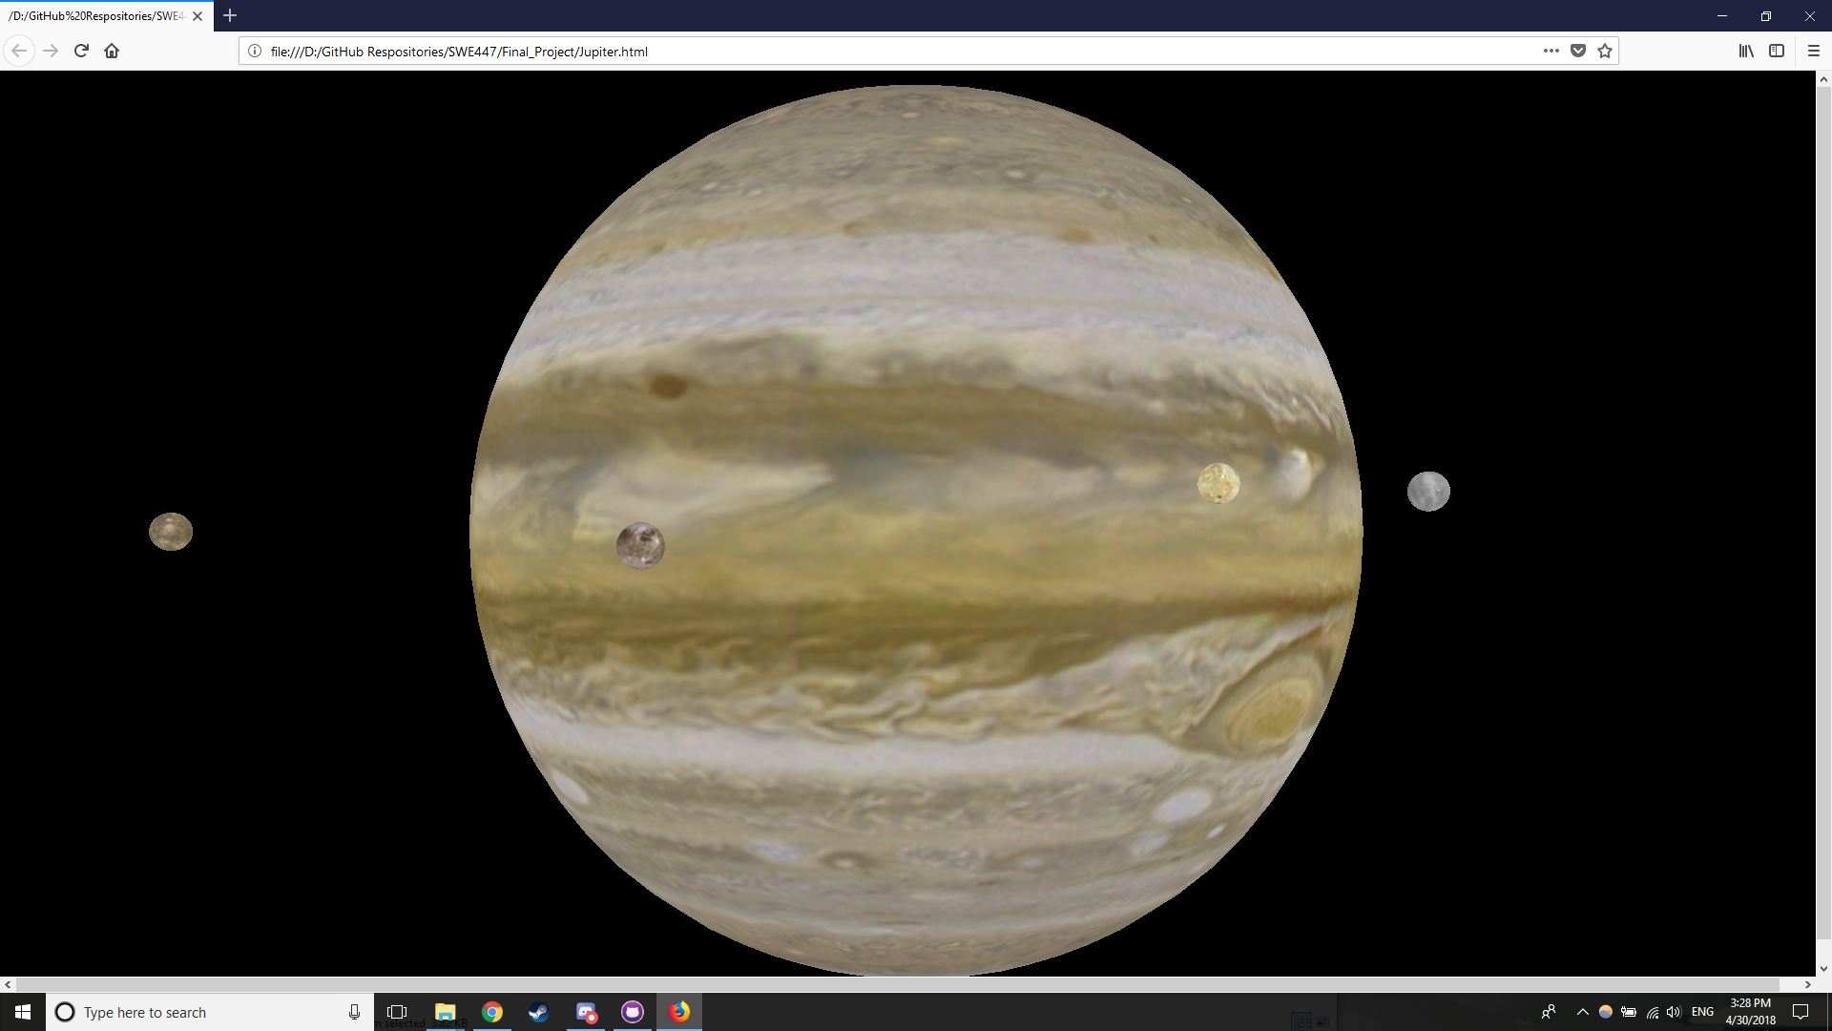
Overview
A simple model of Jupiter and its five largest moons, textured, orbiting, and rotating properly
Accomplished using three.js

Slide 3
Retrospective
Most Challenging Part?
Figuring out Three.js
Most Interesting Part?
The difference between working with and without a library like Three.js
What Would You Have Done Differently?
I would have added interactivity

